Slide 1
The Wise men
Matthew 2:1-12

Slide 2
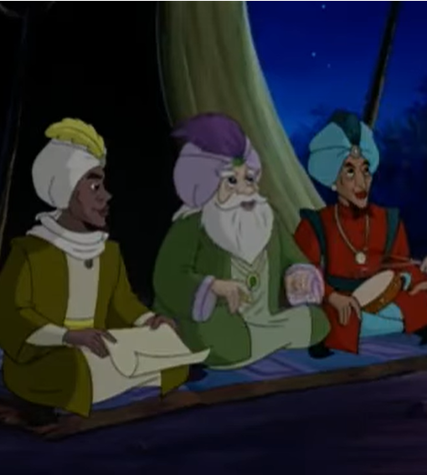
Quiz!
How many Wise Men were there?
What was their job?
What were the gifts of the Wise Men, and were they intentional?
Did the Wise Men see Jesus on the same night as the shepherds?

Slide 3
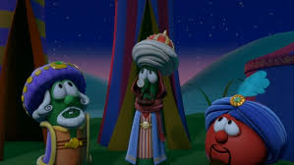
The Wise Men
Who were they? Is there significance in their identities?
They acted on what they understood
Gifts, great joy, active obedience

Slide 4
Matthew 2:1-12
Now after Jesus was born in Bethlehem of Judea in the days of Herod the king, behold, wise men from the east came to Jerusalem, ² saying, “Where is he who has been born king of the Jews? For we saw his star when it rose and have come to worship him.” ³ When Herod the king heard this, he was troubled, and all Jerusalem with him; ⁴ and assembling all the chief priests and scribes of the people, he inquired of them where the Christ was to be born. ⁵ They told him, “In Bethlehem of Judea, for so it is written by the prophet:
“‘And you, O Bethlehem, in the land of Judah,
are by no means least among the rulers of Judah;
for from you shall come a ruler
who will shepherd my people Israel.’”

Slide 5
Matthew 2:1-12
Then Herod summoned the wise men secretly and ascertained from them what time the star had appeared. ⁸ And he sent them to Bethlehem, saying, “Go and search diligently for the child, and when you have found him, bring me word, that I too may come and worship him.” ⁹ After listening to the king, they went on their way. And behold, the star that they had seen when it rose went before them until it came to rest over the place where the child was. ¹⁰ When they saw the star, they rejoiced exceedingly with great joy. ¹¹ And going into the house, they saw the child with Mary his mother, and they fell down and worshiped him. Then, opening their treasures, they offered him gifts, gold and frankincense and myrrh. ¹² And being warned in a dream not to return to Herod, they departed to their own country by another way.

Slide 6
Who were the Wise Men?
“Now after Jesus was born in Bethlehem of Judea in the days of Herod the king, behold, wise men from the east came to Jerusalem, ² saying, “Where is he who has been born king of the Jews? For we saw his star when it rose and have come to worship him.”
Scholars, perhaps astronomers?
From the east
More than 3!
Does it actually matter?

Slide 7
Numbers 24:17
‘I see him, but not now; I behold him, but not near; a star shall come out of Jacob, and a sceptre shall rise out of Israel; it shall crush the forehead of Moab and break down all the sons of Sheth.’

Slide 8
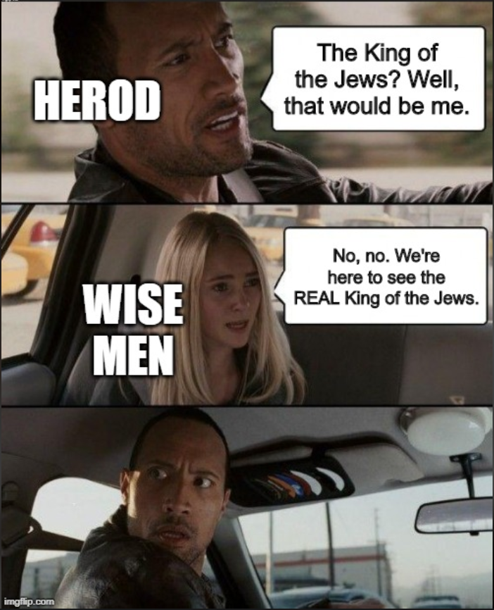
The Wise Men acted on what they understood

Slide 9
Matthew 2:2-6
‘“Where is he who has been born King of the Jews? For we saw his star when it rose and have come to worship him.” When Herod the King heard this, he was troubled, and all Jerusalem with him; and assembling all the chief priests and scribes of the people, he enquired of them where the Christ was to be born. They told him, “in Bethlehem of Judea, for so it is written by the prophet: And you, O Bethlehem, in the land of Judah, are by no means least among the rulers of Judah; for from you shall come a ruler who will shepherd my people Israel.”’

Slide 10
The Wise Men vs the chief priests and scribes
Action vs complacency
Isaiah 6:910 ‘And he said “Go and say this to the people: Keep on hearing, but do not understand; keep on seeing, but do not perceive. Make the heart of this people dull, and their ears heavy, and blind their eyes, lest they see with their eyes, and hear with their ears, and understand with their hearts, and turn and be healed.”’
Psalm 118:22 ‘The stone that the builders rejected has become the cornerstone.”

Slide 11
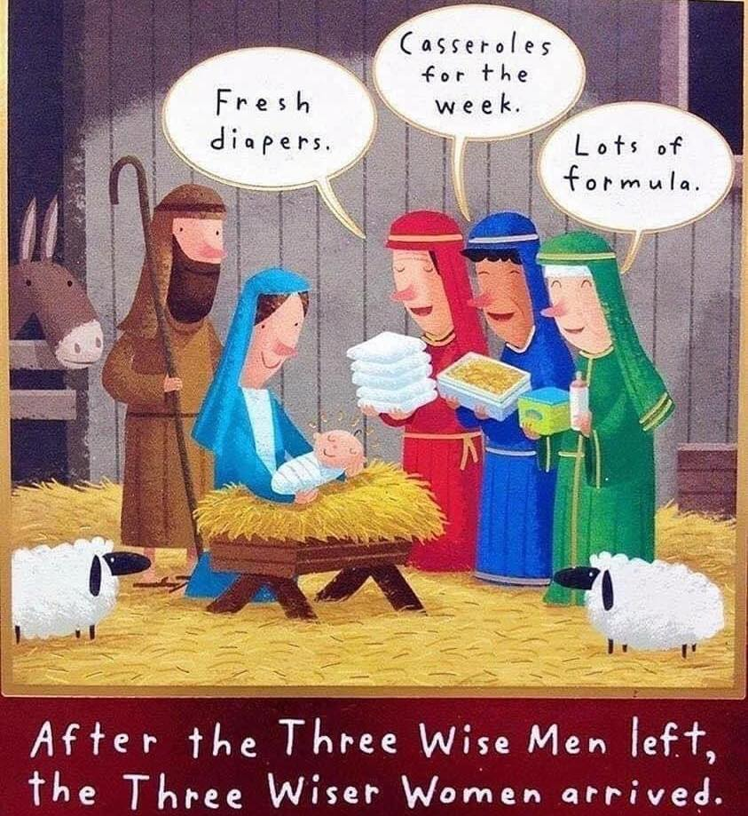
Gifts, great joy, active obedience

Slide 12
Matthew 2:7-11
‘Then Herod summoned the wise men secretly and ascertained from them what time the star had appeared. And he sent them to Bethlehem, saying, “Go and search diligently for the child, and when you have found him, bring me word, that I too may come and worship him.” After listening to the king, they went on their way. And behold, the star that they had seen when it rose went before them until it came to rest over the place where the child was. When they saw the star, they rejoiced exceedingly with great joy. And going into the house, they saw the child with Mary his mother, and they fell down and worshiped him. Then, opening their treasures, they offered him gifts, gold and frankincense and myrrh.’

Slide 13
Gold
Royalty and an indicator of kingship
Isaiah 9:6 “For to us a child is born, to us a son is given, and the government shall be upon his shoulder, and his name shall be called Wonderful Counsellor, Mighty God, Everlasting Father, Prince of Peace.”
Zechariah 9:9 “rejoice greatly, O daughter of Zion! Shout aloud, O daughter of Jerusalem! Behold, your king is coming to you; righteous and having salvation is he, humble and mounted on a donkey, on a colt, the foal of a donkey.”

Slide 14
Frankincense
Divinity and role as High Priest
Hebrews 7:26-28 “For it is indeed fitting that we should have such a high priest, holy, innocent, unstained, separated from sinners, and exalted above the heavens. He has no need, like those high priests, to offer sacrifices daily, first for his own sins and then for those of the people, since he did this once for all when he offered up himself. For the Law appoints men in their weakness as high priests, but the word of the oath, which came later than the law, appoints a Son who has been made perfect forever.”

Slide 15
Myrrh
Pointed to Jesus’ death
Isaiah 53:4-5 “Surely he has borne our griefs and carried our sorrows; yet we esteemed him stricken, smitten by God, and afflicted. But he was wounded for our transgressions; he was crushed for our iniquities; upon him was the chastisement that brought us peace, and with his stripes we are healed.”

Slide 16
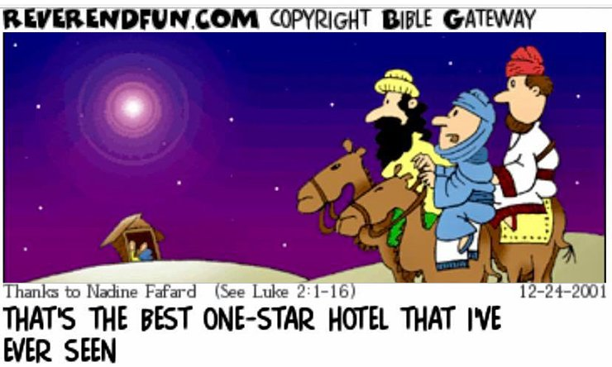

Slide 17
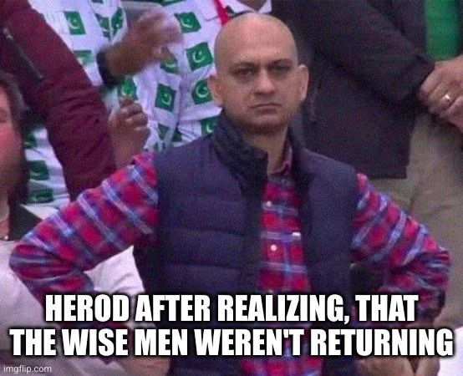
Matthew 2:12
“And being warned in a dream not to return to Herod, they departed to their own country by another way.”

Slide 18
